Slide 1
Comp 55
Use Cases, Scenarios
Assignments

Slide 2
Agenda
Assignments Revisited
Requirements
Use Cases
Scenarios
Chapter 3

Slide 3
About basecamp
Everything should go there
Quick run-through
Will have something for coding too.
USE IT

Slide 4
Use Case Discussion

Slide 5
Requirements
Word doc
Can start working on use cases and scenarios now
Notes:
By word doc, tell them the requirements analysis document is now online and they can get to it.

Slide 6
Now Chapter 3

Slide 7
Get into groups
Have one person open up socrative

Slide 8
Answer same questions
Provide a summary of the chapter
What are the main points that were made in the chapter?
How can you apply this chapter to your upcoming project?
May use notes or book

Slide 9
Last question
How are the points in this chapter different than what was discussed in chapter 2?

Slide 10
My main ideas

Slide 11
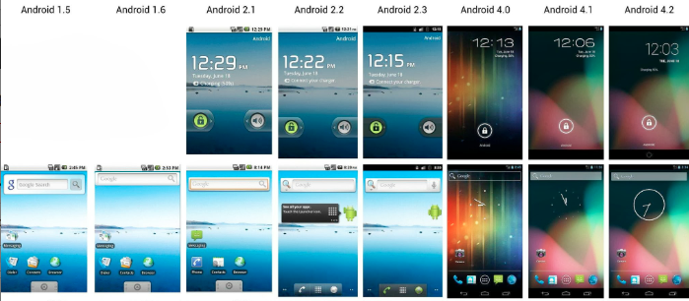
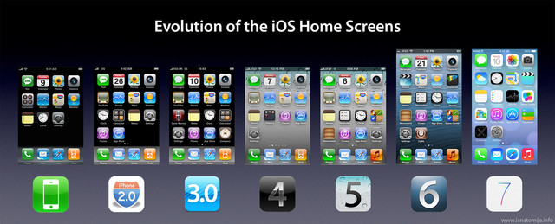

Slide 12
Bark Recognizer
What will change?
Notes:
Hardware, use case, code

Slide 13





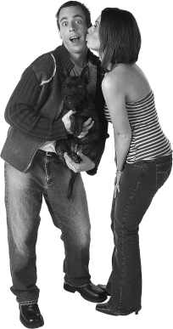
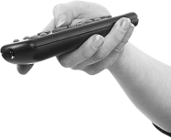
The old scenario
Gina, open the dog door…Fido won’t quit barking!
Woof! Woof!
Woof! Woof!
I feel much better now!
6.1
The door shuts automatically.
1
Fido barks to be let out.
Todd or Gina hears Fido barking.
2
3
Todd or Gina presses the button on the remote control.
6.2
Fido barks to be let back inside.
4
The dog door opens.
Again with the barking! Someone let Fido back inside
5
Fido goes outside.
6
Fido does his business.
6.3
Todd or Gina hears Fido barking (again).
6.4
Todd or Gina presses the button on the remote control.
8
The door shuts automatically.
7
Fido goes back inside.
6.5
The dog door opens (again).
Notes:
This scenario describes the way our product, as implemented at the end of the last chapter, is used. How do we need to change it for the new requirements.

Slide 14


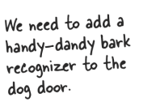

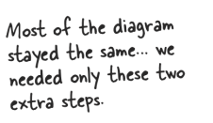
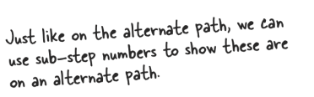
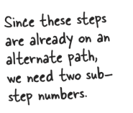
The new scenario
Gina, open the dog door…Fido won’t quit barking!
Woof! Woof!
Woof! Woof!
Todd or Gina hears Fido barking.
2
3
Todd or Gina presses the button on the remote control.
I feel much better now!
6.1
The door shuts automatically.
Fido barks to be let back inside.
1
Fido barks to be let out.
The bark recognizer “hears” a bark.
6.2
2.1
4
The dog door opens.
Again with the barking! Someone let Fido back inside
3.1
The bark recognizer sends a request to the door to open.
5
Fido goes outside.
6.3.1
The bark recognizer “hears” a bark (again).
6.4.1
The bark recognizer sends a request to the door to open.
6
Fido does his business.
6.3
Todd or Gina hears Fido barking (again).
6.4
Todd or Gina presses the button on the remote control.
7
Fido goes back inside.
8
The door shuts automatically.
6.5
The dog door opens (again).
Notes:
Here’s one way we might change the scenario. There are others that would work as well.

Slide 15
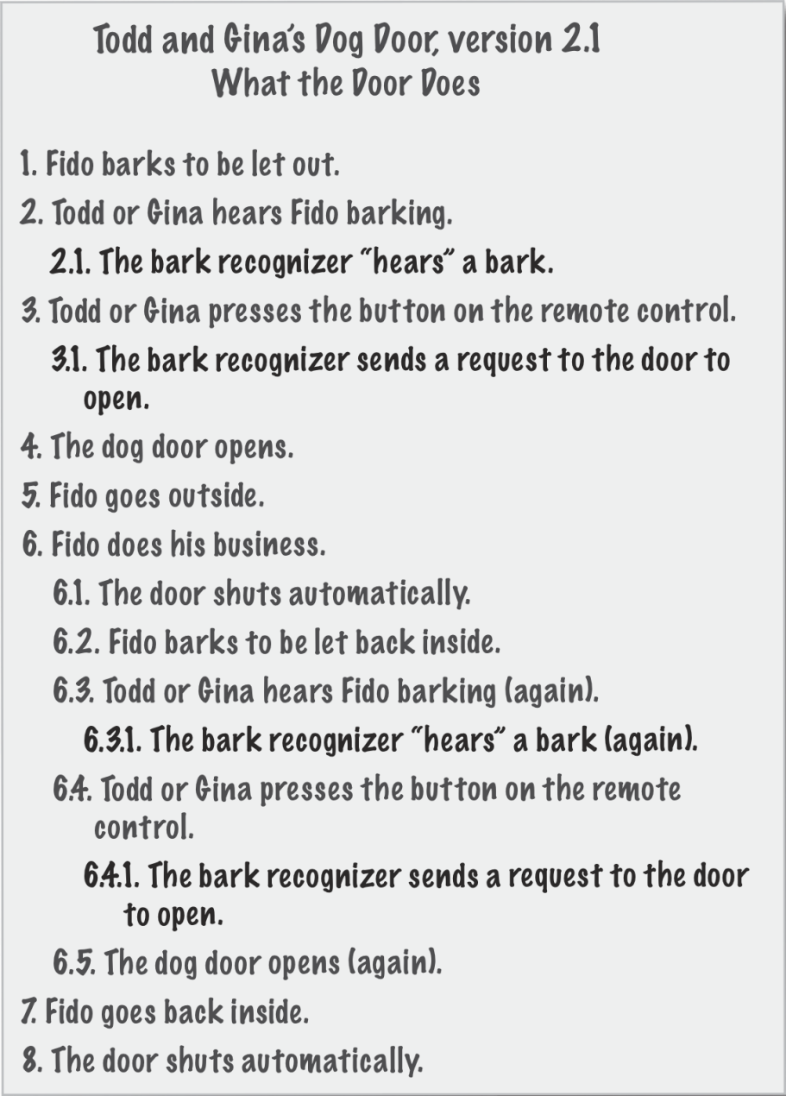
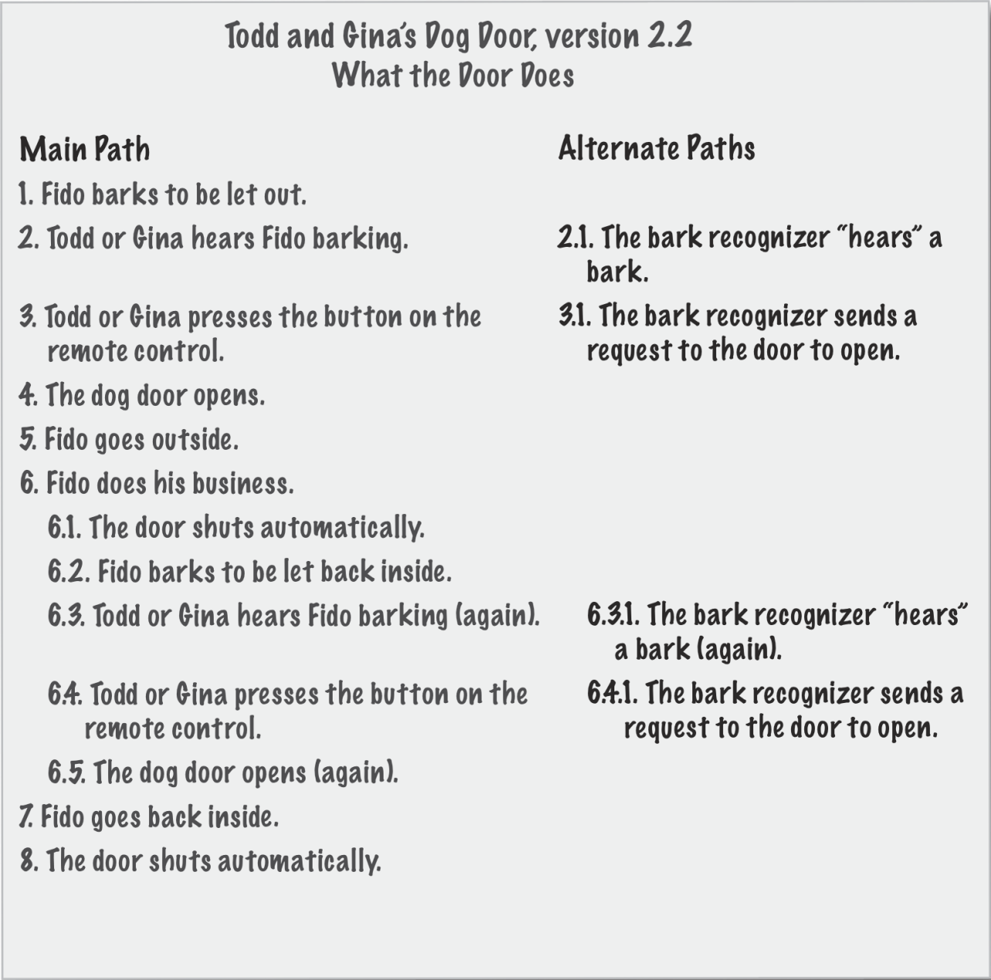
Point about use cases?
Notes:
Needs to be important to you!

Slide 16
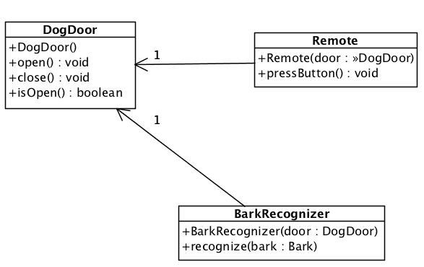
Our new design
Notes:
Here’s a new design that we want to use for our new version of the system. Make sure you understand the diagram. Is there a similarity between Remote and BarkRecognizer?
Notice that the parameter to the recognize method is an instance of a Bark and we haven’t put a Bark class in the diagram. Is this a problem? Well it is if this represented the final system. But for now, it’s okay. You’ll see when we get to the code that we’ll use a String for now, until we get the real details. In fact the code we’ve got in the book and in the slides simulates the hardware since we really don’t have the hardware. One thing we want to do in our systems is make it easy to test for correctness even when we don’t have all of the parts we need to finish the system for delivery to the customer.

Slide 17
new BarkRecognizer class
public class BarkRecognizer {
private DogDoor door;
public BarkRecognizer(DogDoor door) {
this.door = door;
}
public void recognize(String bark) {
System.out.println(" BarkRecognizer: Heard a '" + bark + "'");
door.open();
}
}
Notes:
There’s not a lot complexity here. It’s not too hard to write the code from the previous diagram. Which is easier to understand, the diagram or the code? Actually, as with most answers—it depends. It depends on what you’re trying to understand. If you want to understand how the system is organized, the diagram is a great way of getting the higher-level view; while if you really want to see how everything is implemented, you need to look at the code. On single view suffices.

Slide 18

It’s really great that we applied the Information Expert.
Why is it so great?
Is there a principle here?
(pg 135-140)
Notes:
Remember that we’ve already moved the responsibility for closing the door to the DogDoor class so we don’t have to deal with the issue in the book on pp. 135-140. Remember, we applied the Information Expert pattern to our design and moved the responsibility for automatically closing the door to the DogDoor class. What would we have had to do with our new design if we hadn’t refactored the code?

Slide 19
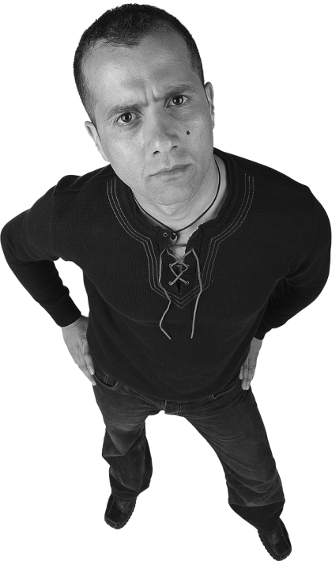
Why not follow this thought?
Just copy the code for closing the door automatically from the Remote to the BarkRecognizer.
Notes:
Maybe we happened to get lucky with our application of the Information Expert pattern on our code. If we hadn’t, the solution seems simple to Doug, who’s a manager, not a programmer. What do you think of his solution. It certainly seems simple enough. In fact that’s often the problem. People who aren’t programmers or involved with software development think that a change can just be implemented with the most obvious, simple solution (to them).

Slide 20
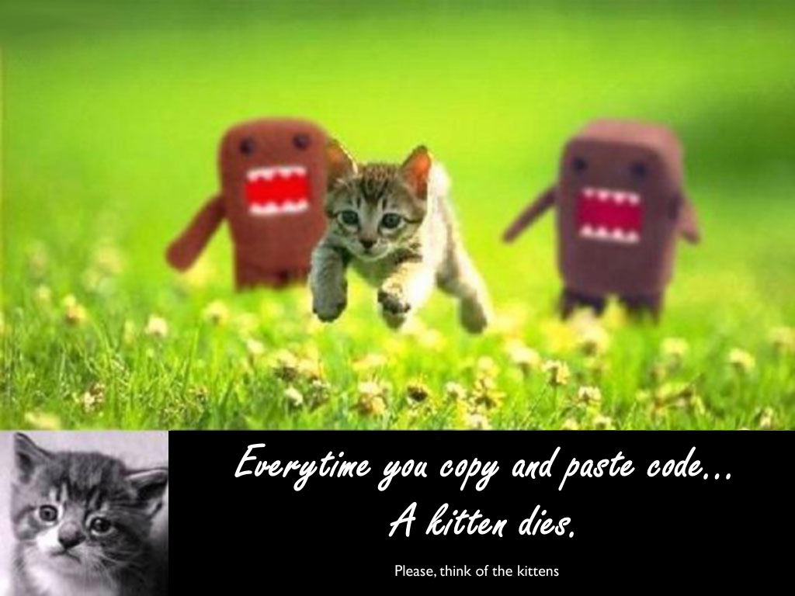
Copying and pasting code

Slide 21
What’s wrong with Doug’s idea?
1
You might copy the code incorrectly
2
You might copy it again
3
Mo copies Mo Problems
(When Requirements Change)
4
It ain’t got not alibi!
Notes:
There are a few things that we can think of that are wrong about Doug’s idea. Try to come up with your own list and see how it compares to our list.
(Answers appear on click)

Slide 22
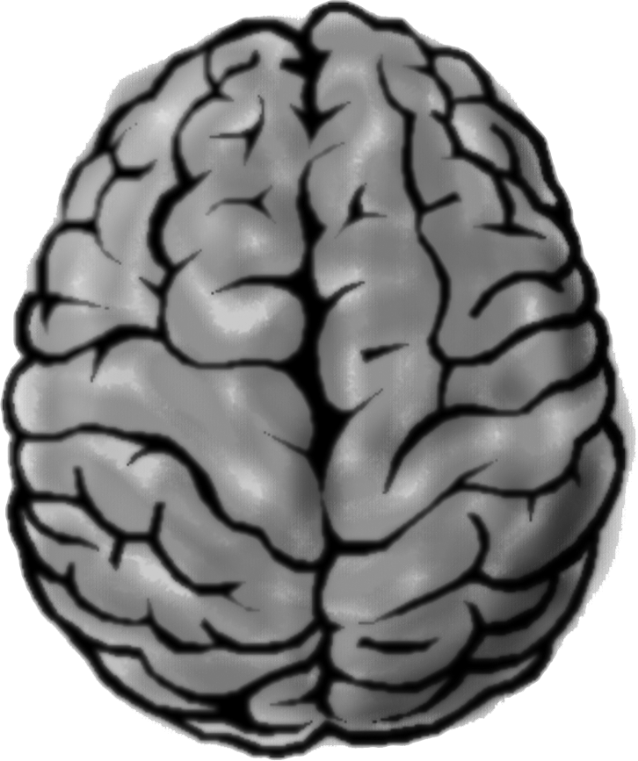
Things to think about
Are the Remote and the BarkRecognizer similar?
Can you encapsulate the similarities?
How would this change the system?
We haven’t implemented a Bark class. How would you do that?
What do we gain from it?

Slide 23
Back to use case app
DJ for party
Get ready to show to me by the end
Let’s focus on user first.
Traffic Jam Analysis, Requirements Spec,
Should always be working on this class
Notes:
You have a use cases for DJ App

Slide 24
Team Activity
Requirements:
A DJ’ing app to support college parties
Collaborative Playlist
One DJ Admin to start/stop music
Your task:
1. Write a Use Case for this app, (assume speakers are setup)
2. Write a Scenario for that use case instead
Not sure what these are? Ask team & others
Notes:
Concrete represetion of the requirements, the last thing wasn’t enough, gotta discuss with everyone how things are going to work.

Slide 25
My version of the use case
Partygoer

Slide 26
Partygoer arrives at the party
Partygoer opens app and goes to attendee mode
Enters party name
Looks at other songs selected and votes up songs they like, votes down songs they hate
Does not like any of the songs so suggests a new song
Closes the app
Partygoer logs back in because they haven’t heard the song, so wants to check where it is on the queue
Votes additional songs up and down.
Tries to game the system by voting all the songs down
Message pops up for a limit on number of songs voted down for the party
Song plays

Slide 27
Now try to do the Admin side

Slide 28
DJ/Admin gets ready for the party
Sets up the speakers & Connects tablet to the speakers
Opens up the App and goes into Admin mode
Puts in settings for maximum number of songs in playlist, genres to exclude, and name of party
DJ/Admin decides to test the sound by playing “Never gonna give you up” by Rick Astley
DJ/Admin adjusts speaker levels to match what is wanted
DJ/Admin presses the button again and stops the music.
Waits until the party starts, and then presses the start party button, and a predefined music list starts to play
As songs are suggested they get added to the playlist, so order of songs and what is coming up changes
The party becomes a rager
Someone sets off the fire alarm
DJ/Admin must pause the music
Fire Chief says it’s ok
DJ/Admin hits play and music resumes from where it left off
DJ/Admin ends the party by stopping the music.

Slide 29
Group time

